Slide 1
Oksana Stepanova
Case Study
Influenza Season – Data Research Project
GitHub

Slide 2


Project Overview
The United States has an influenza season where more people than usual suffer from the flu.
Some people, particularly those in vulnerable populations, develop serious complications and end up in the hospital.
Hospitals and clinics need additional staff to adequately treat these extra patients. The medical staffing agency provides this temporary staff.
The objective of the project is to assist the medical staffing agencies with the preparation plan for the upcoming influenza season.
The agency covers all hospitals in each of the 50 states of the United States.
Our task is to determine when to send staff, and how many, to each state.

Slide 3
Data – Tools - Skills
Data
Influenza deaths by geography, time, age, and gender
Influenza lab test results by state
Source: CDC
Population data by geography
Source: US Census Bureau
Skills
Project management | Understanding Business Requirements Document (BRD), formulating research hypothesis, creating project management plan.
Data quality | Creating a data profile, explaining a data set and data limitations
Statistical Analysis | Calculating variance and standard deviation, testing a correlation. Formulating and testing statistical hypothesis.
Data visualization | Displaying in Tableau: time forecast, histograms & boxplots, scatter plots & bubble charts, maps, word cloud.
Storytelling & Data Presentation | Dashboard in Tableau
Tools
Excel
Tableau

Slide 4
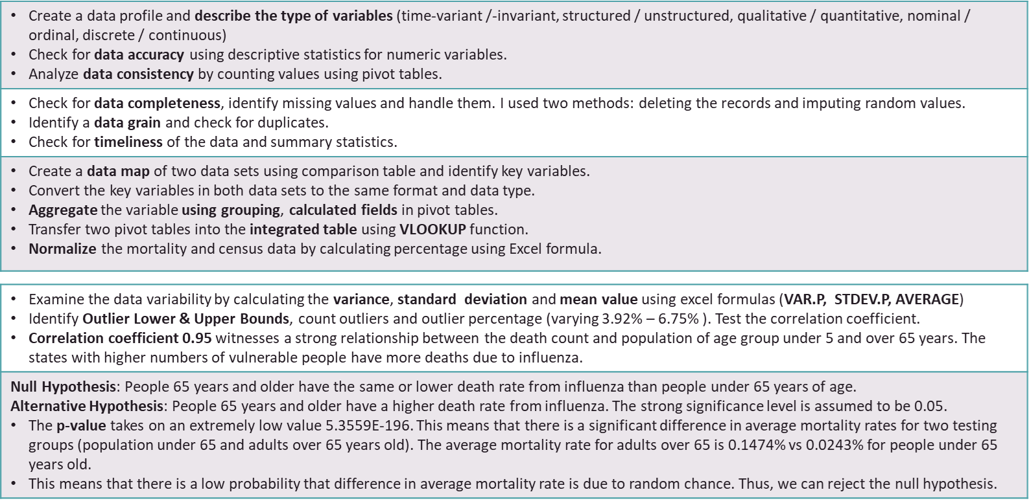
Conducting Statistical Analysis
Data Profiling & Integrity
Data quality measures
Data transformation & Integration
Statistical Analysis
Hypothesis Testing
4

Slide 5
Challenges & Solutions Handling missing values
Influenza mortality data
There are 54013 'Suppressed' values which accounts 82% of all values for influenza deaths count.
As per data source CDC, Death counts are suppressed for statistics representing zero to nine (0-9) deaths.
Solution:
#1: Using a supplementary date source.
#2: Imputing values (average value). For the range from 0 to 9 the range value would be 4.5. For death count, we should use only discrete values. That means, the average would be 5 after rounding off.
Chosen method:
I replaced 'Suppressed' by random values. I used RANDBETWEEN function to impute the missing values.
State name column
There are 144 #N/A values under the state name for 2011.
Solution:
#1: removing these 144 rows which account 0.2% of data. It could be acceptable as it is less than 5%.
#2: imputing the missing state name.
Chosen method:
The missing state name corresponds to state code 11.
I filtered the rows using code 11 and replaced the N/A for the state name 'District of Columbia' corresponding to the code 11 in other 1152 rows.

Slide 6
Challenges & Solutions Data Transformation & Integration
 | Data Set: Influenza | Exemple | Notes |  |  | Data Set: Census | Exemple | Notes
1 | State | Alabama | 50 states and District of Columbia |  | 1 | County | Autauga County, Alabama | State in Influenza data set County in Census data set are partially overlapped. We will extract the State title.
2 | State Code | 1 | 1-56, we will not use it |  | 2 | State | Alabama | 50 states, District of Columbian and Puerto Rico (unincorporated U.S territory). Puerto Rico is excluded from Influenza Mortality data set according to CDC data description. We will use VLOOKUP function and extra rows with Puerto Rico observations will not be integrated into final dataset.
3 | Year | 2009 | 2009-2017. Data is totally overlapped in both data sets |  | 2 | Year | 2009 | 2009-2017. Data is totally overlapped in both data sets
4 | Month | Apr., 2009 | We won't use it |  | 3 | Total population | 49584
5 | Month Code | 2009/04 | We won't use it |  | 4 | Male Total population | 24057
6 | Ten-Year Age Groups | < 1 year | Influenza death count of two groups (<1 year and 1-4 years) to be grouped to overlap Census data. |  | 5 | Female Total population | 25527
 |  | 1-4 years |  |  | 6 | Under 5 years | 3421 | The population count overlap the Influenza data from 2 groups
 |  | 15-24 years |  |  | 7 | 5 to 9 years | 3570 | The census data in this 2 columns will be grouped to overlap the data in Influenza Death data set.
 |  | 25-34 years |  |  | 8 | 10 to 14 years | 4413
 |  | 35-44 years |  |  | 9 | 15 to 19 years | 4016
 |  | 45-54 years |  |  | 10 | 20 to 24 years | 2727
 |  | 5-14 years |  |  | 11 | 25 to 29 years | 2876
 |  | 55-64 years |  |  | 12 | 30 to 34 years | 3025
 |  | 65-74 years | We will combine the data of these three groups into 'over 65 years' group because BRDdefines vulnerable population as adults over 65 years old. |  | 13 | 35 to 39 years | 3520
 |  | 75-84 years |  |  | 14 | 40 to 44 years | 4363
 |  | 85+ years |  |  | 15 | 45 to 49 years | 3967
7 | Ten-Year Age Groups | 1 | Influenza death count of two groups (<1 year and 1-4 years) to be grouped to overlap Census data. |  | 16 | 50 to 54 years | 3223
 |  | 1-4 |  |  | 17 | 55 to 59 years | 2628
 |  | 15-24 |  |  | 18 | 60 to 64 years | 2430
 |  | 25-34 |  |  | 19 | 65 to 69 years | 1983 | We will combine the data of these three groups into 'over 65 years' group because BRD defines vulnerable population as adults over 65 years old.
 |  | 35-44 |  |  | 20 | 70 to 74 years | 1438
 |  | 45-54 |  |  | 21 | 75 to 79 years | 893
 |  | 5-14 |  |  | 22 | 80 to 84 years | 645
 |  | 55-64 |  |  | 23 | 85 years and over | 496
 |  | 65-74 | We will combine the data of these three groups into 'over 65 years' group because BRD defines vulnerable population as adults over 65 years old.
 |  | 75-84
 |  | 85+
Integrating two data sets to create one data set.
I used Data mapping technique as in the table on the right.
I selected the Influenza Mortality data as a primary data set.
I pasted the Influenza data from Influenza table (totally based on the Pivot table)
I copied the census variables using VLOOKUP formula from Census table aggregated in pivot table.
Influenza death percentage is calculated using an arithmetic formula.

Slide 7
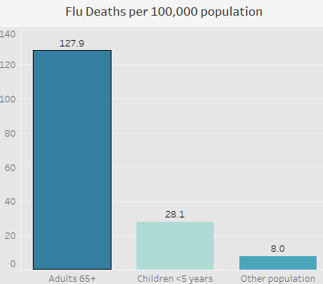
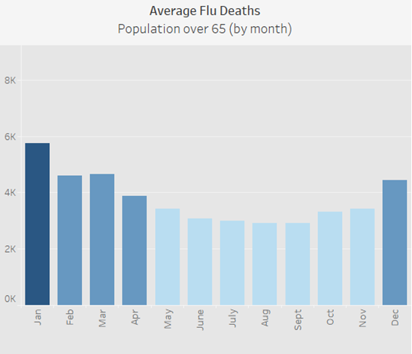
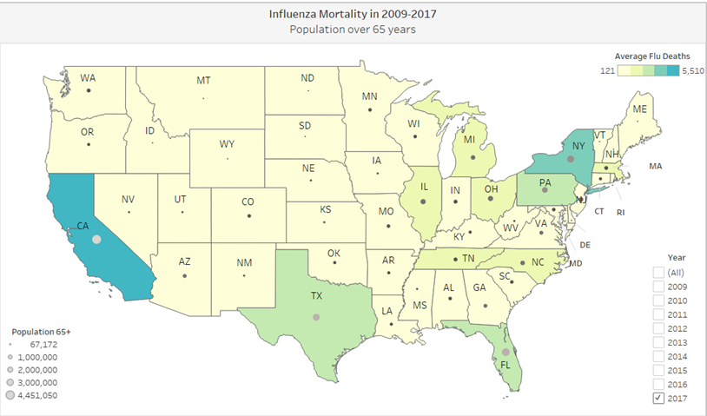
Data Visualization
Who suffers most from flu complications?
Influenza kills 127 out of 100 ths adults over 65 and 28 out of 100 ths children under 5 years, while among the rest of the population there are 8 deaths registered out of 100 ths people.
When is the peak of flu season?
Influenza occurs seasonally: historically, the lowest death rate among vulnerable population is recorded in July - September, and the peak occurs in January – March.
Where are the most flu patient?
The forecast for the next flu season matches best the 2017 trend. Based on 2017 trend, the top 5 states with high flu death rates are California, New York, Florida, Pennsylvania and Texas.
7

Slide 8
Visual design
Color is another way of communicating information and in my Tableau dashboard I followed the basic principals of data visualization.
I used monochromic blue scale with variations of shades, tones and tint to depict the mortality rate by month. This scale is color-blind-friendly.
I used the darkest color to highlight the most important information, for instance, the month with the highest mortality rate or the U.S. states on the map with the highest average flue death.
I used not more than five colors even on the map presenting more than fifty U.S. states to adhere the principal of simplicity.

Slide 9
Recommendations & My learning insights
People over 65 years are at higher risk of developing flu complications. As a result, the state with the high rate of aging population will need additional medical staff.
The next flu season will highly likely begin in December with the highest flu rates in January. The level of flu cases will probably remain high in February and March. I anticipate that hospitals will have a critical need for additional medical personnel from December to March.
Using influenza mortality rates as an indicator of influenza severity, U.S. states are classified as having high, medium, and low health care needs.
I recommend developing a staffing plan that prioritizes the allocation of additional health care personnel to states with higher potential influenza mortality rates and high rates of population aging.
It is important to consider data limitations to understand the data incompleteness or data inaccuracy and then to determine if the data is relevant for the purpose of analysis and how we can handle the issue with data accuracy.
Data mapping helps to match the variable and to understand how to transform them to integrate two data sets into one.
Excel formulas and Tableau visualization allow us to conduct descriptive and statistical analysis. The important step of the analysis is the interpretation of statistical coefficients.
Tableau is a powerful tool that we can use for analysis and to create a story board for project presentation.

Slide 10


Thank you!
Oksana Stepanova
Links to more deliverables
Tableau Storyboard GitHub Repo

